Slide 1




ContentMine and WikiData
Peter Murray-Rust
Wikimania,
London UK 2014-08-08

Slide 2
ContentMine: We use machines to liberate 100 million facts /yr from the scientific literature and make them free for everyone (WikiData) With Wikipedia we are ALL scientists ContentMine is a social machine WikiData is the future of science data

Slide 3
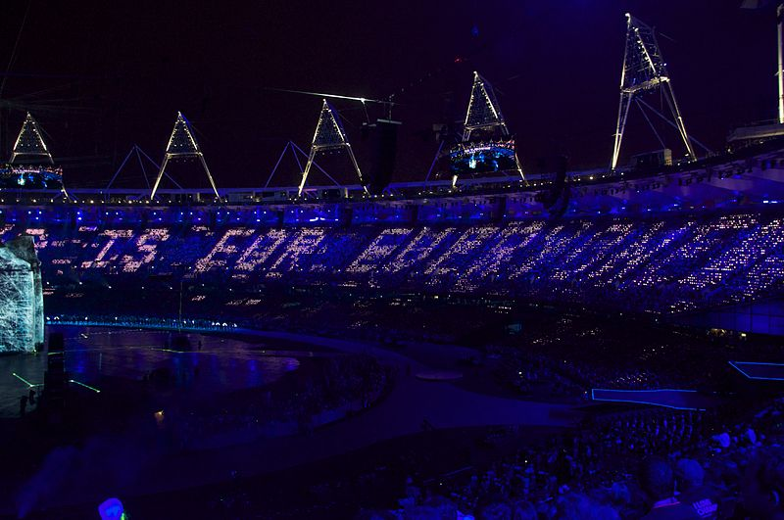
http://en.wikipedia.org/wiki/Tim_Berners-Lee
Everything in this presentation is ODOSOS
(Open Data, Open Standards, Open Source)
CC0, CC-BY, W3C etc., Apache2, etc. *
http://contentmine.org
http://bitbucket.org/petermr
http://wwmm.ch.cam.ac.uk
A promise: I (Petermr) will never sell out to non-transparent organizations.
*Sorry about the Powerpoint (Power corrupts, Powerpoint corrupts absolutely (Tufte))

Slide 4
petermr: I believe in Wikipedia
2006 http://en.wikipedia.org/wiki/User:Petermr
2006 started Open Data (term unknown then!)
2009: “the bit of Wikipedia that I wrote is correct” [challenging the idea of “WP is junk”]
2009: “Wikipedia is the digital library of this century”
2012: I alert WP that Springer has copyrighted > 1000 of our images [Springergate]
2014: “For facts in maths, physical and biological sciences I trust Wikipedia.” (Wikimania2014)

Slide 5
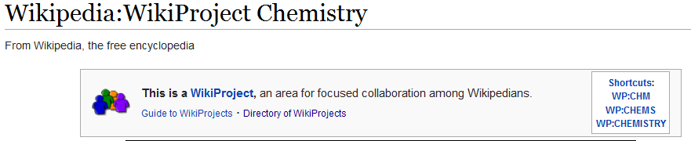
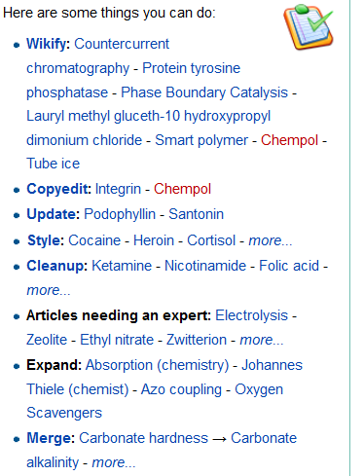
A meritocratic
critical
volunteer
community

Slide 6
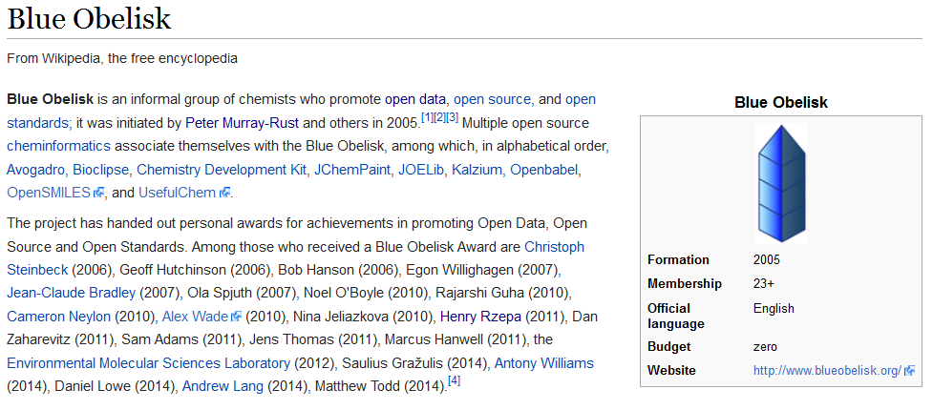
Volunteer community in chemistry: Open Data/Source/Standards

Slide 7
Scientific and Medical publication (STM)[+]
World Citizens pay $400,000,000,000…
… for research in 1,500,000 articles …
… cost $300,000 each to create …
… $7000 each to “publish” [*]…
… $10,000,000,000 from academic libraries …
… to “publishers” who forbid access to 99.9% of citizens of the world …
[+] Figures probably +- 50 %
[*] arXiV preprint server costs $7 USD per paper

Slide 8
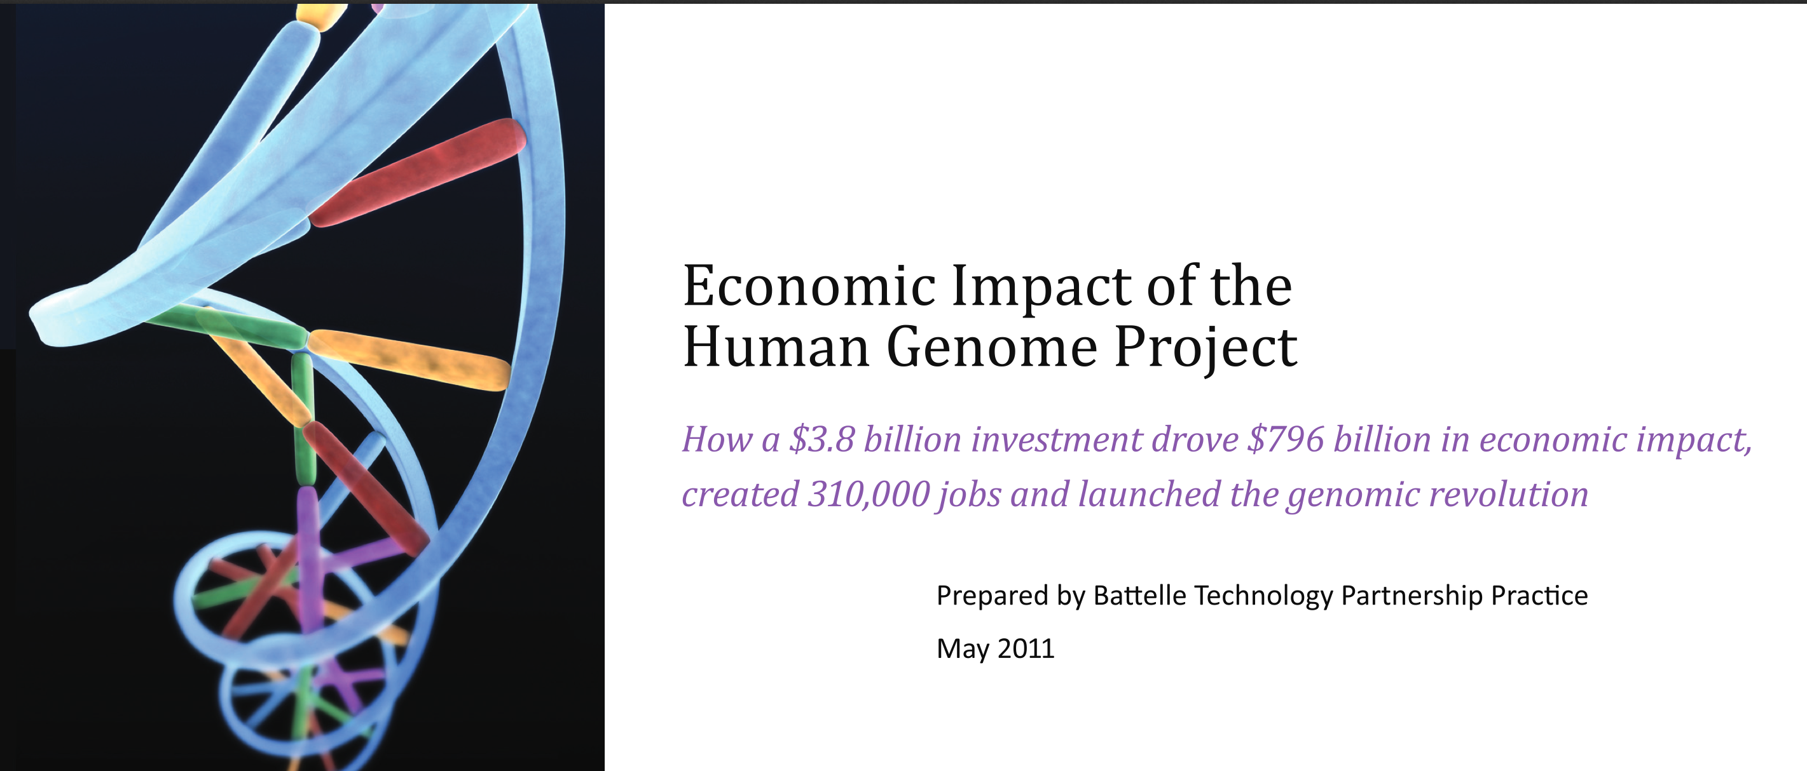
4 Billion USD on human genome
yielded 800 Billion USD and 4 M job-years

Slide 9
Gloom Warning

Slide 10
Bad publication wastes science
…three problems—flawed design, non-publication, and poor reporting—together meant >85% of research funds were wasted, a global total loss >100 billion USD per year. [Lancet 2009]
[Even more] waste clearly occurs after publication: from poor access, poor dissemination, and poor uptake of the findings of research. [PLOS Medicine 2014-05-27]

Slide 11
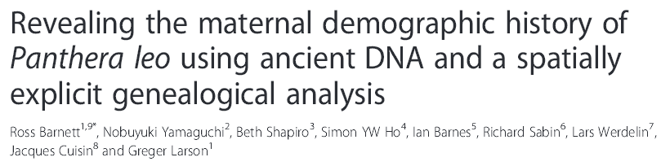

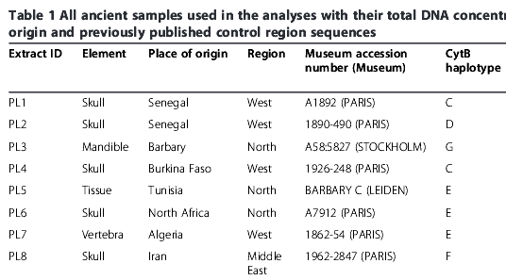
Publishers’ PDFs destroy science
PDFs do not contain words or subscripts!
PDFs do not contain tables and do not have columns
SVG is turned into JPEG because it’s easier to process

Slide 12
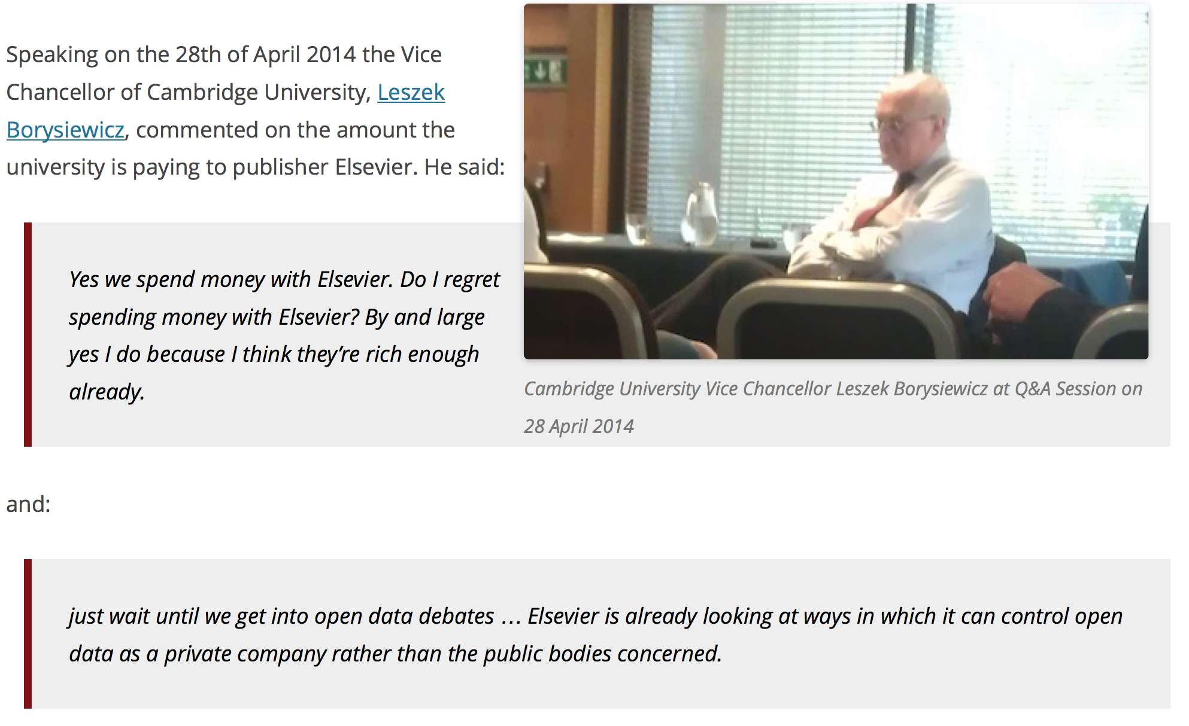
Elsevier wants to control Open Data
[asked by Michelle Brook]

Slide 13
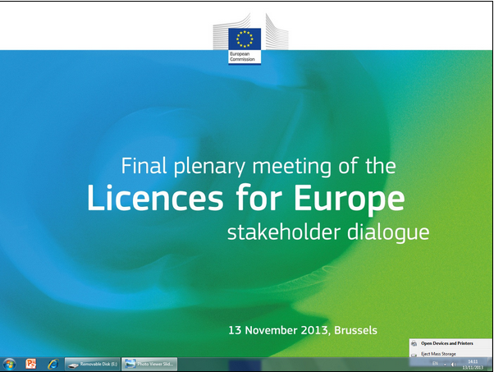
Licences destroy Content Mining
WE WALKED OUT
Brit Library
JISC
RLUK
OKFN
…
Ross Mounce
PM-R
STM Publishers Licence
2012_03_15_Sample_Licence_Text_Data_Mining.pdf
(Summary: PMR has NO rights)
[cannot publish to: ] “libraries, repositories, or archives”
[cannot] “Make the results of any TDM Output available on an externally facing server or website”
“Subscriber shall pay a […] fee”
Heather Piwowar: “negotiating with publishers [made me physically ill]”

Slide 14
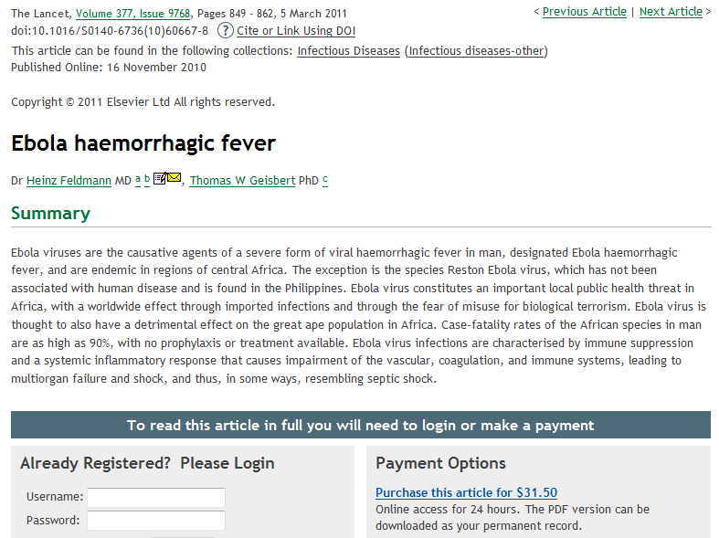
CLOSED ACCESS MEANS PEOPLE DIE
CLOSED DATA MEANS PEOPLE DIE

Slide 15
Happiness Restored

Slide 16
http://www.budapestopenaccessinitiative.org/read
… an unprecedented public good. …
… completely free and unrestricted access to [peer-reviewed literature] by all scientists, scholars, teachers, students, and other curious minds. …
…Removing access barriers to this literature will accelerate research, enrich education, share the learning of the rich with the poor and the poor with the rich, make this literature as useful as it can be, and lay the foundation for uniting humanity in a common intellectual conversation and quest for knowledge.
(Budapest Open Access Initiative, 2003)

Slide 17
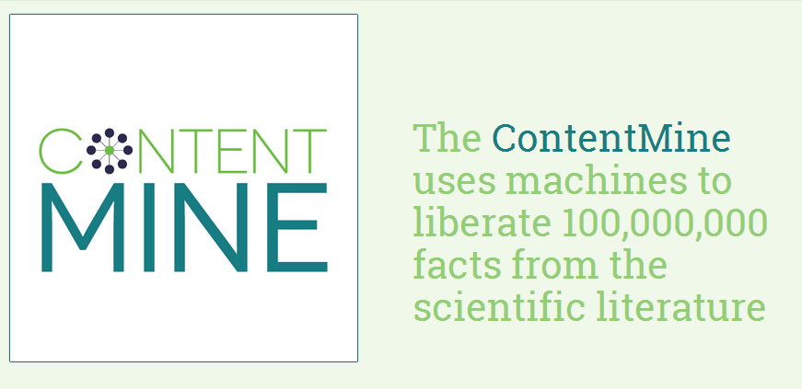

The Right to Read is the Right to Mine
http://contentmine.org

Slide 18
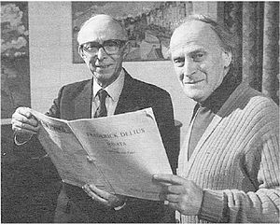
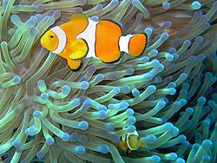
Science can be read and understood by human-machine Amanuensis-symbionts.
Amanuenses are based on Wikipedia, databases and software (e.g. ContentMine’s AMI)
The results are fed back into WP and WikiData
http://en.wikipedia.org/wiki/Eric_Fenby
http://en.wikipedia.org/wiki/Symbiosis

Slide 19
Machine Extraction of scientific facts
Crawl scientific literature
(Open Bibliography)
Scrape each scientific article
(ContentMine-quickscrape)
Extract the facts (ContentMine-AMI)
Index (Wikipedia)
Republish (WikiData)

Slide 20
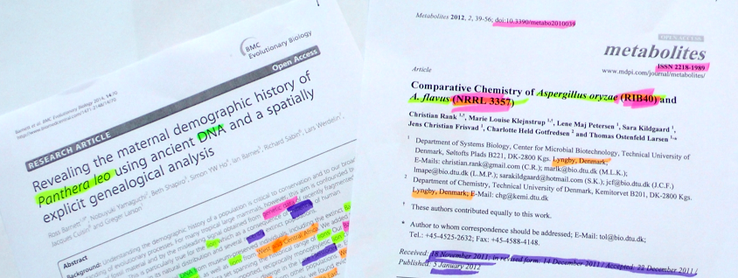
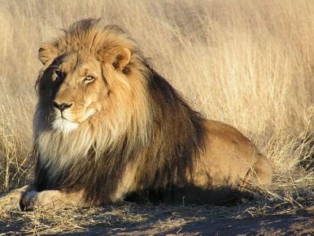
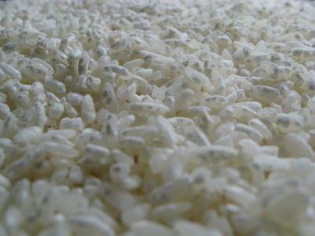
Human-machine symbionts can read science!
WP_Aspergillus_oryzae
WP_Soybean
WP_Lion

Slide 21
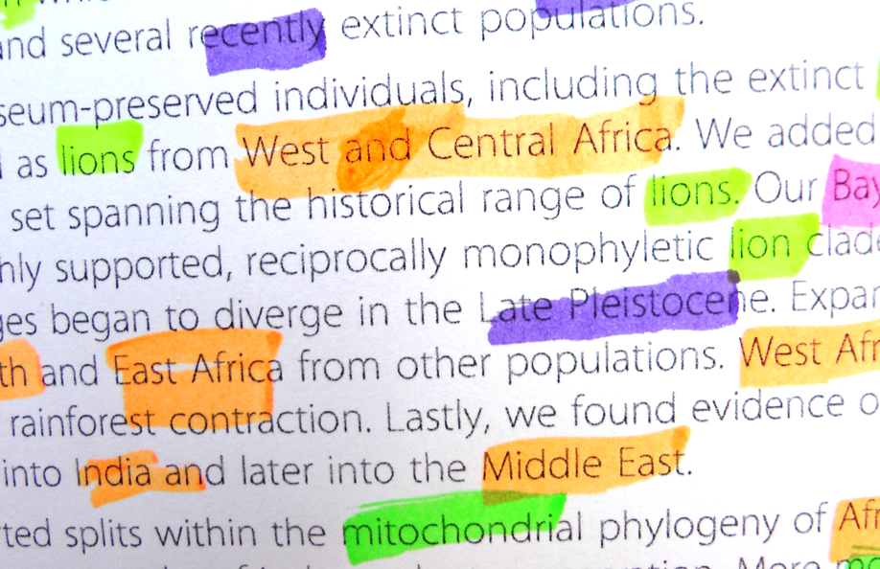
With Wikipedia everyone can be a scientist
Facts Marked by “non-scientists” in ContentMine workshops

Slide 22
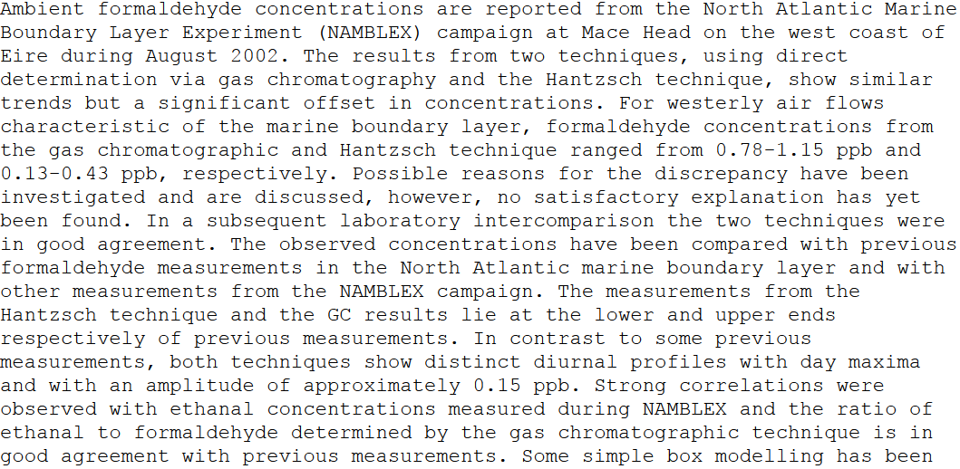
“nuggets” in a scientific paper
places
project
Value ranges
quantity
units
chemical
Humans aren’t designed to mine this … ☹

Slide 23
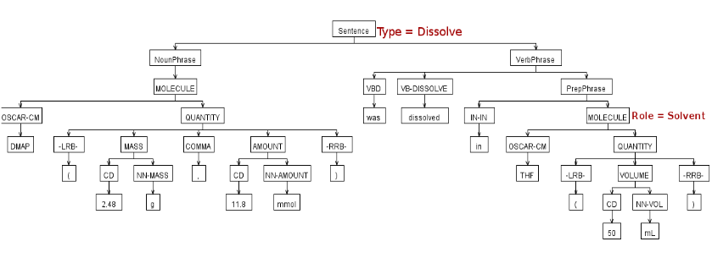
Parsing chemical sentences
A FACT, uncopyrightable, and representable by triples

Slide 24
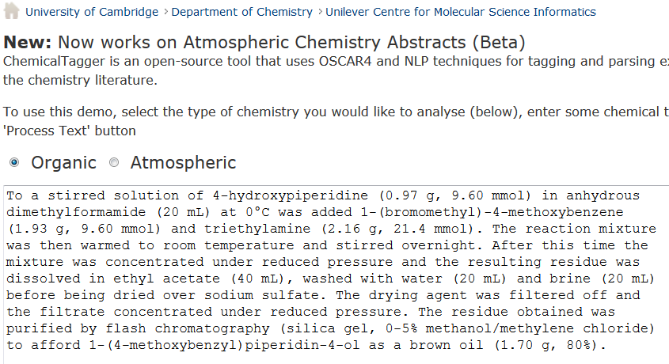
http://wwmm.ch.cam.ac.uk/chemicaltagger
Typical
Typical chemical synthesis

Slide 25
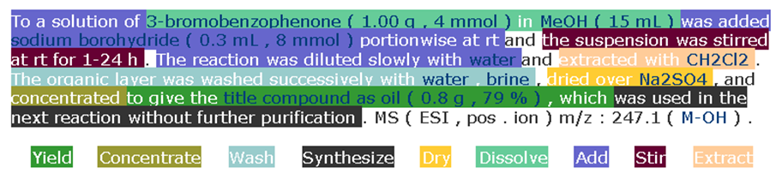
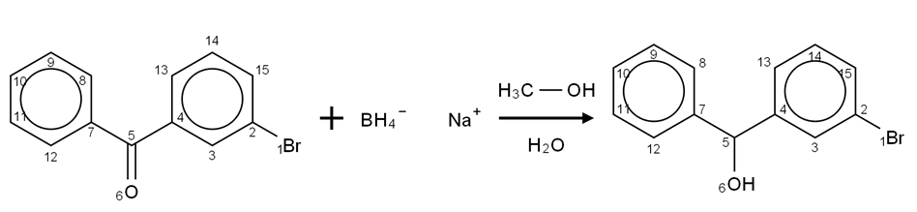
Open Content Mining of FACTs
Machines can interpret chemical reactions
We have done 500,000 patents. There are > 3,000,000 reactions/year. Added value > 1B Eur.

Slide 26
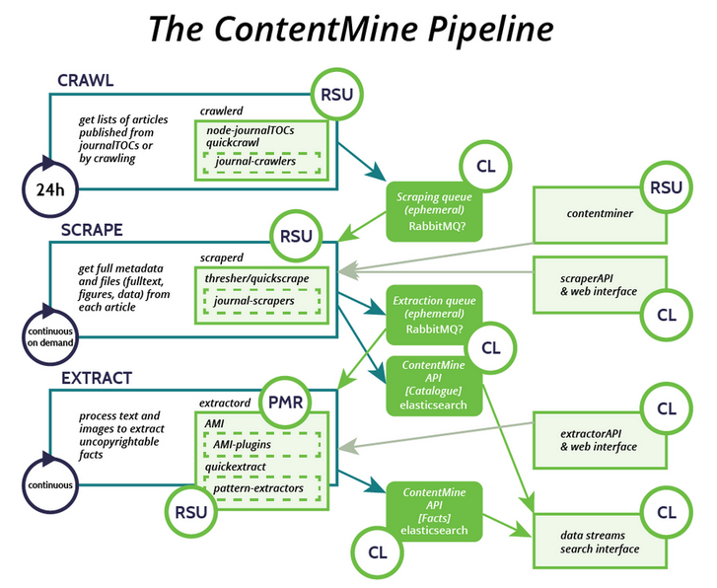

Scientific
literature
Queues
Repos
Science
Plugins
Science
Volunteers
RSU: Richard Smith-Unna
PMR: Peter Murray-Rust
CL: CottageLabs

Slide 27
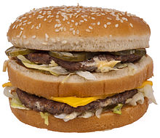
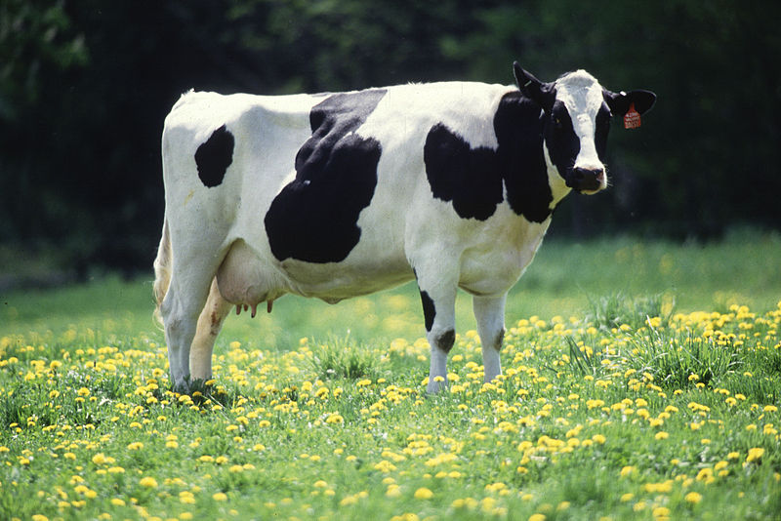
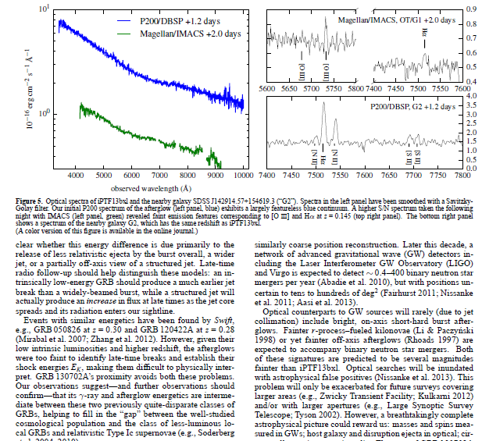
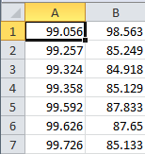
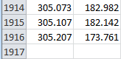
But we can now turn PDFs into Science
We can’t turn a hamburger into a cow

Slide 28
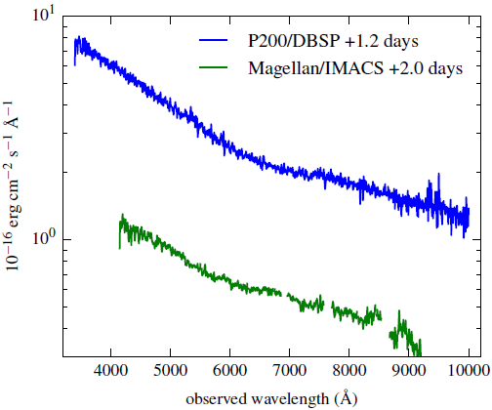
TITLES
DATA!!
2000+ points
UNITS
TICKS
SCALE
QUANTITY

Slide 29
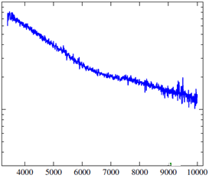
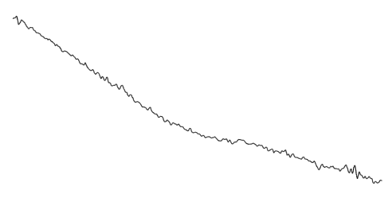
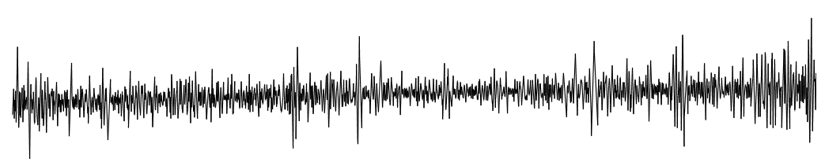
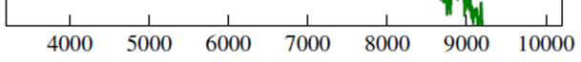
Dumb PDF
Automatic
extraction
CSV
Takes < 1 second
Semantic
Spectrum
Gaussian Filter
2nd Derivative

Slide 30
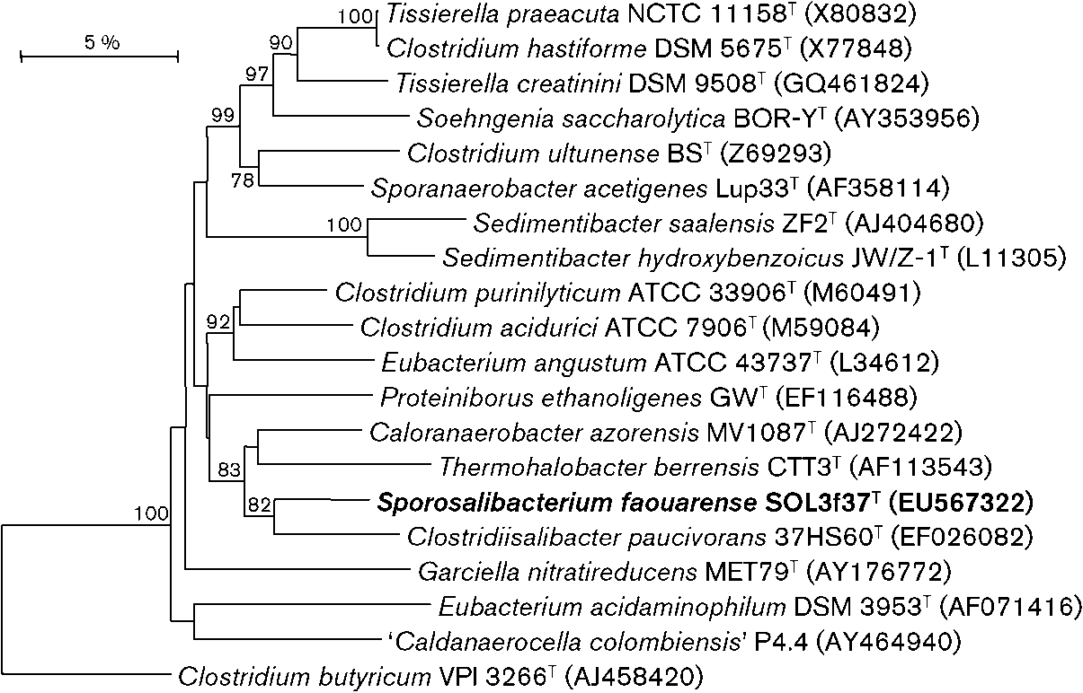
Bacterial WP_phylogenetic tree
Genbank ID
American Type
Culture Collection
WP: Clostridium_butyricum
Our machines have read and interpreted 4300 in an hour with > 95% accuracy
Trees From http://ijs.sgmjournals.org/ used under new UK legislation (Hargreaves)

Slide 31
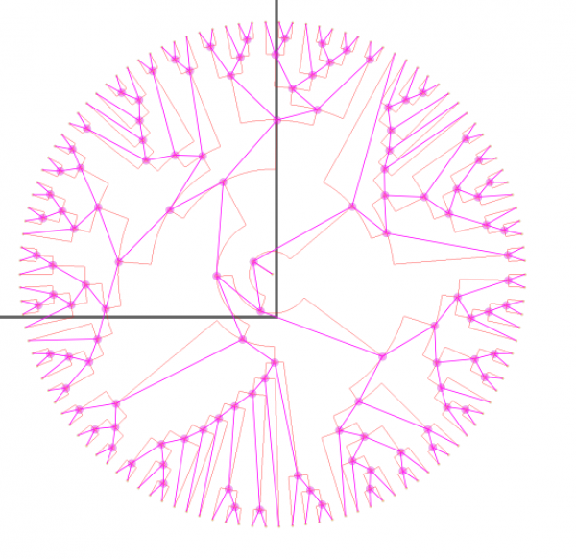
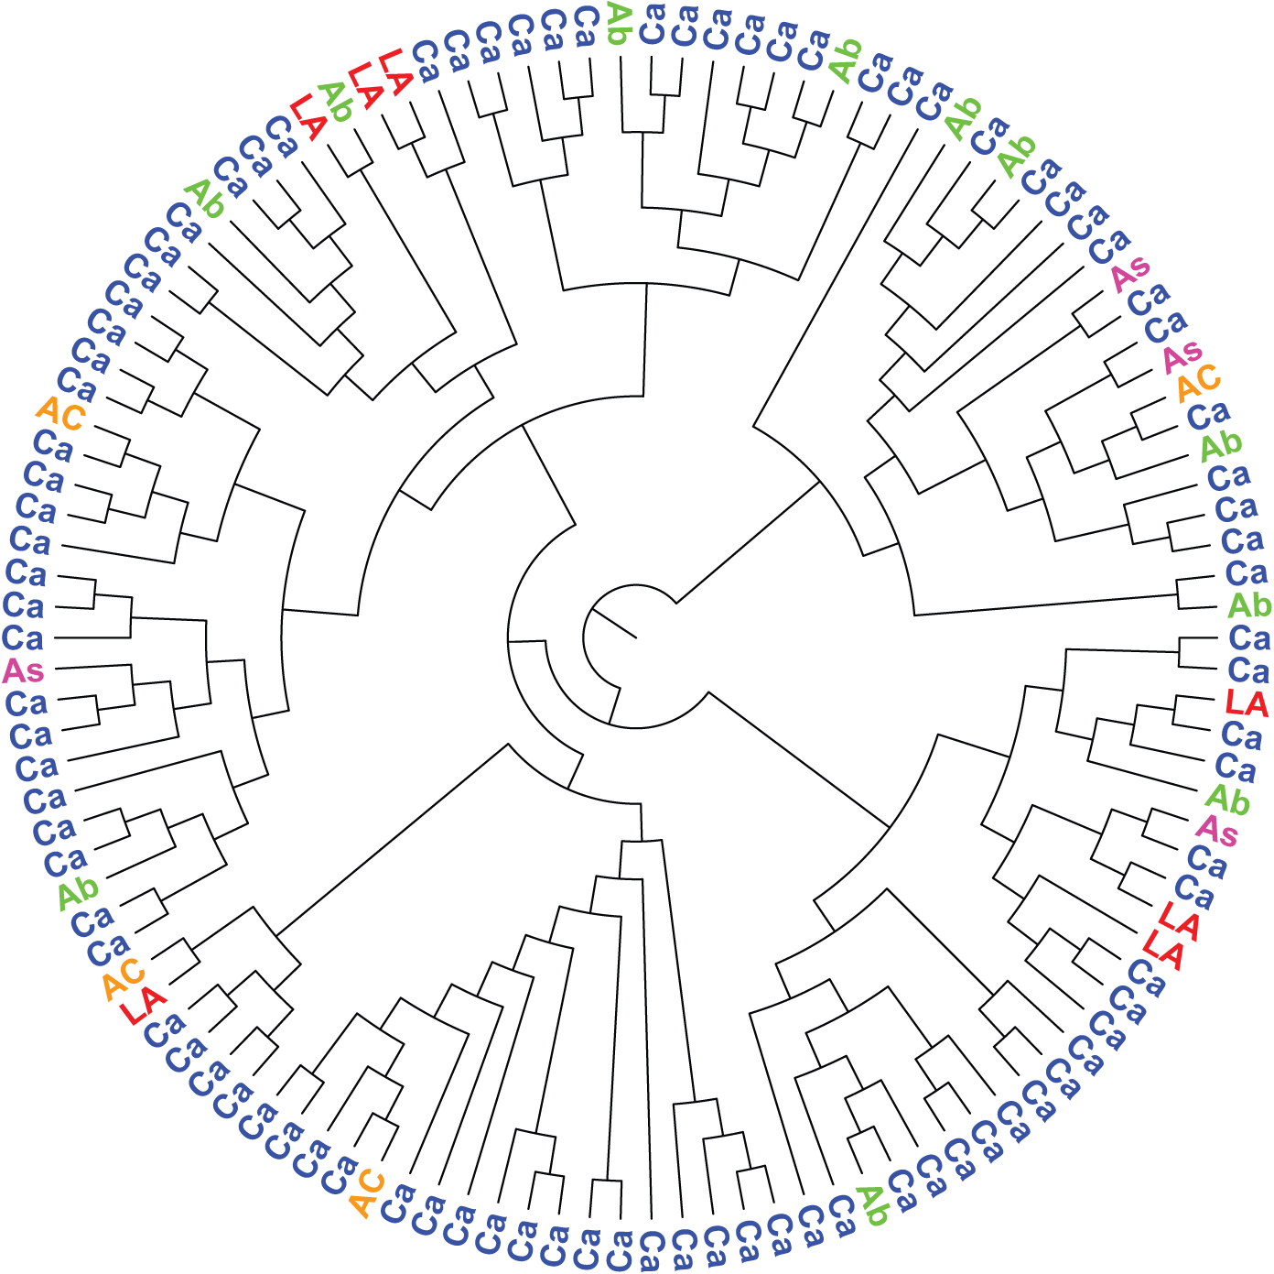
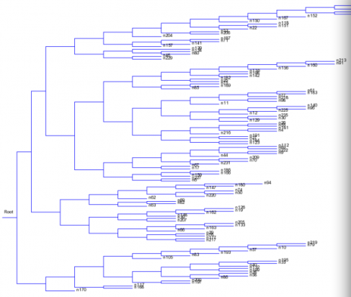
http://en.wikipedia.org/wiki/Digital_image_processing
http://en.wikipedia.org/wiki/Newick_format
http://en.wikipedia.org/wiki/Phylogenetics
((n122,((n121,n205),((n39,(n84,((((n35,n98),n191),n22),n17))),((n10,n182),((((n232,n76),n68),(n109,n30)),(n73,(n106,n58))))))),((((((n103,n86),(n218,(n215,n157))),((n164,n143),((n190,((n108,n177),(n192,n220))),((n233,n187),n41)))),((((n59,n184),((n134,n200),(n137,(n212,((n92,n209),n29))))),(n88,(n102,n161))),((((n70,n140),(n18,n188)),(n49,((n123,n132),(n219,n198)))),(((n37,(n65,n46)),(n135,(n11,(n113,n142)))),(n210,((n69,(n216,n36)),(n231,n160))))))),(((n107,n43),((n149,n199),n74)),(((n101,(n19,n54)),n96),(n7,((n139,n5),((n170,(n25,n75)),(n146,(n154,(n194,(((n14,n116),n112),(n126,n222))))))))))),(((((n165,(n168,n128)),n129),((n114,n181),(n48,n118))),((n158,(n91,(n33,n213))),(n87,n235))),((n197,(n175,n117)),(n196,((n171,(n163,n227)),((n53,n131),n159)))))));
(http://www.plosone.org/article/info%3Adoi%2F10.1371%2Fjournal.pone.0036933 – “Adaptive Evolution of HIV at HLA Epitopes Is Associated with Ethnicity in Canada” .

Slide 32
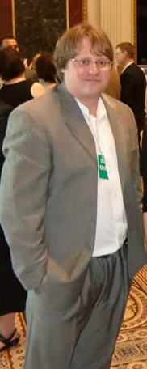
Open notebook science is the practice of making the entire primary record of a research project publicly available online as it is recorded. (WP)
Jean-Claude Bradley was a chemist who actively promoted Open Science in chemistry,… He coined the term Open Notebook Science. … A memorial symposium was held July 14, 2014 at Cambridge University, UK.^{[9]}

Slide 33
Scientific
literature
Queues
Repos
Science
Plugins
Science
Volunteers
RSU: Richard Smith-Unna
PMR: Peter Murray-Rust
CL: CottageLabs

Slide 34
My Wikiwishes
An Open Bibliography of science, updated daily
An interface for ContentMine to feed new facts into WikiData
Domain-specific enthusiasts to create and run fact extraction and validation
Wikipedia to become a C21 publisher of science

Slide 35
Thanks
Shuttleworth Foundation and Fellowship
Contentmine.org: Michelle Brook, Jenny Molloy, Ross Mounce, Richard Smith-Unna, CottageLabs, Charles Oppenheim
Open Knowledge Foundation Community
Wikimedia Community
Blue Obelisk Community

